Slide 1
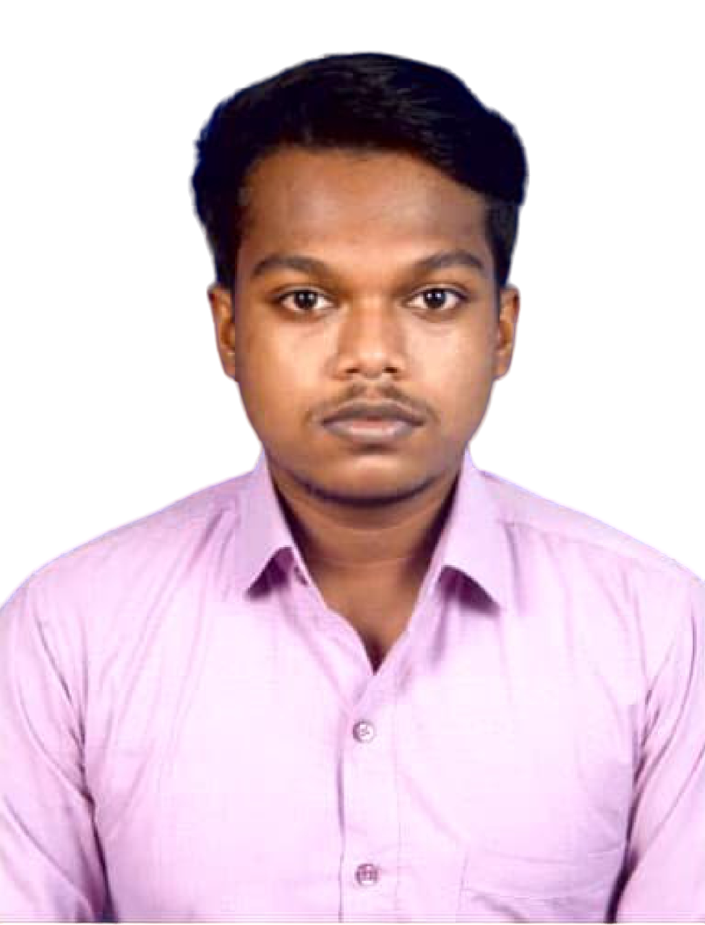

Deepsubho Gayen
Bachelor of Technology,
Mechanical(Automobile) Engineering : 2018-22
Analyst/Software Engineer
I Transform L&D Left shift batch
MUMBAI
Skills
deepsubho.gayen@capgemini.com
C# | Basics, OOPS, Exception Handling ,Arrays ,Collection and Generics, Delegates and Events, File Io and Serialization.
.NET Framework | ADO.NET,ASP.NET with MVC5 and WEB API, Entity Framework
JAVA | Basics, OOPS, Exception Handling ,Arrays
Database | SQL
Tools | GIT,POSTMAN
UI Technology | HTML5 ,CSS & Angular
Add On Skills | Communication Skills, Team Management
+91 7908285530
A4
Full Stack Developer
Understanding of RDBMS concepts using SQL Server.
Practical understanding of C# and SQL concepts using Visual Studio and SQL Server
Hands on experience in developing applications using .NET Framework, ADO.NET Core, ASP.NET core.
Understanding of HTML5 , CSS and Angular CLI.
Project Link
Completed case study on Railway Reservation System which is a Web-based System. Railway Reservation System is implemented to make life of commuters easier by helping them to search trains , book tickets , cancel tickets and fulfilling other related needs within their reach just by visiting the website. The main objective of the Railway Reservation System is to act as a bridge between the commuters and the organization by registering themselves as Passengers and to avail all kind of facilities.
Technologies used:
ASP.NET CORE
Microsoft SQL Server
Angular

